Slide 1


RDKit Node Wizard
Manuel Schwarze
Novartis Institutes of Biomedical Research, NIBR IT
Basel, January 2012

Slide 2
Wizard Main Idea: Simplify Your Live
Main goal: Shorten the time to develop new nodes based on RDKit Library
Write less code
Focus on science
Refactor existing code to detect common pattern and create abstract base classes as well as utility classes
Create templates for major node types

Slide 3
Main Patterns
Core manipulations are done
Sometimes additional calculations before or after the core manipulation are required
There can be intermediate results
Handling of settings is more or less the same
Merging of tables
Creation of new tables
Row filtering of tables

Slide 4
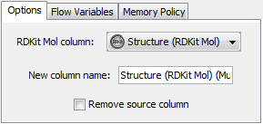
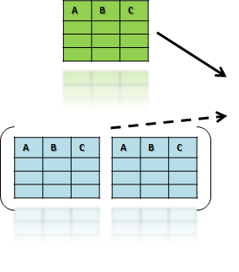
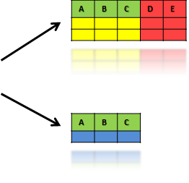

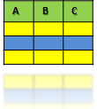
Main Pattern
Settings
Via Member Variables
End Results
Input
Data
Step 1
(Pre-Processing)
X%
Step 2
(Core-Processing)
(100 – X – Y)%
Step 3
(Post-Processing)
Y%
Via Member Variables
Via Member Variables
and Parameters
Via Member Variables
&
Settings
Intermediate Results
(e.g. Tables, Variables)

Slide 5
Wizard Templates: Calculator
Usage:
Calculation of additional columns for a set of input data based on settings and other input data
A | B | C
A | B | C | D | E
A | B | C
A | B | C
Calculator

Slide 6
Wizard Templates: Calculator
Input:
1 main table with data the calculation is based on
Optional: n other tables influencing data calculation
Output:
1 table that is merged with the input main table
Optional: m other tables
Samples:
RDKit Fingerprint
RDKit Murcko Scaffold

Slide 7
Wizard Templates: Modifier
Usage:
Calculation of new table(s) based on input data and settings, often part of the input are merged in
A | B | C
A | B | C | D | E
A | B | C
A | B | C
Modifier
A | B | C
A | B | C

Slide 8
Wizard Templates: Modifier
Input:
1 main table with data the calculation is based on
Optional: n other tables influencing data calculation
Output:
1 table that is created as new table
Optional: m other tables
Samples:
RDKit Mol Fragmenter

Slide 9
Wizard Templates: Splitter
Usage:
Generation of multiple output tables containing the subsets of data of one main input table based on settings and other input data
A | B | C
A | B | C
A | B | C
A | B | C
A | B | C
Splitter

Slide 10
Wizard Templates: Splitter
Input:
1 main table with data to split up
n other tables influencing splitting operation
Output:
m tables with subsets of main input table
Samples:
RDKit Functional Group Filter (not implemented)
RDKit Sub Structure Filter (not implemented)

Slide 11
Wizard Templates: Filter
Usage: (Special case of Splitter)
Generation of one output table that contains a subset of data of one main input tablebased on settings and other input data
A | B | C
A | B | C
A | B | C
A | B | C
Filter

Slide 12
Wizard Templates: Filter
Input:
1 main table with data to filter
n other tables influencing filtering operation
Output:
1 table with subsets of main input table
Samples:
RDKit Diversity Picker

Slide 13
Wizard Templates: Calculator & Splitter
Usage:
Calculation of additional columns for a subset of input data and additional splitting, all done based on settings and other input data
A | B | C
A | B | C | D | E
A | B | C
A | B | C
Calculator &
Splitter
A | B | C

Slide 14
Wizard Templates: Calculator & Splitter
Input:
1 main table with data to split up
n other tables influencing calculation and splitting operation
Output:
m tables with subsets of main input table, possibly with additional columns as calculation results
Samples:
Molecule to RDKit

